Slide 1
How Does Light Inclination Affect the Amount of Heat Received from a Heat Source?

Slide 2
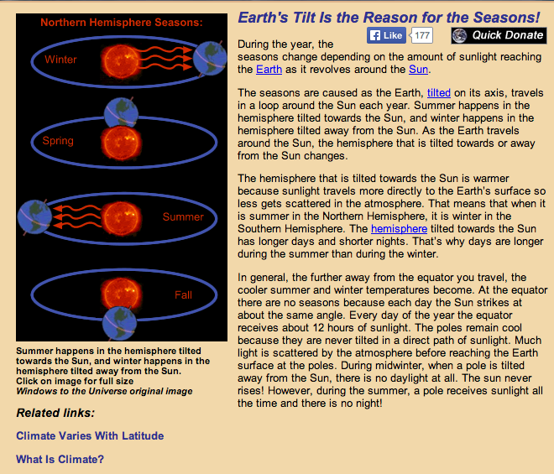
Highlight Key Information

Slide 3
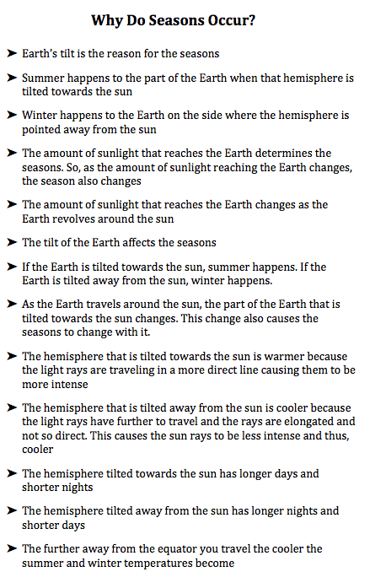
Made Lists of Facts for Each Subtopic

Slide 4
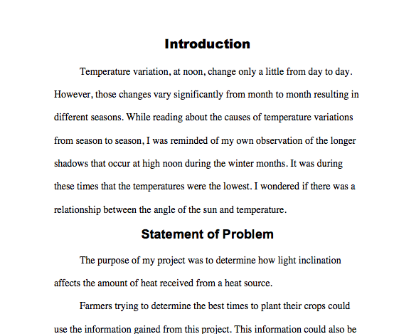
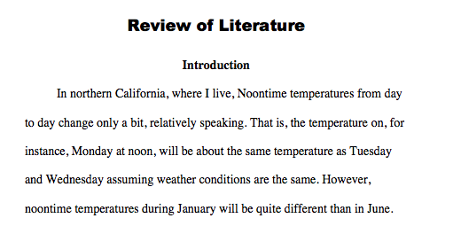

Slide 5
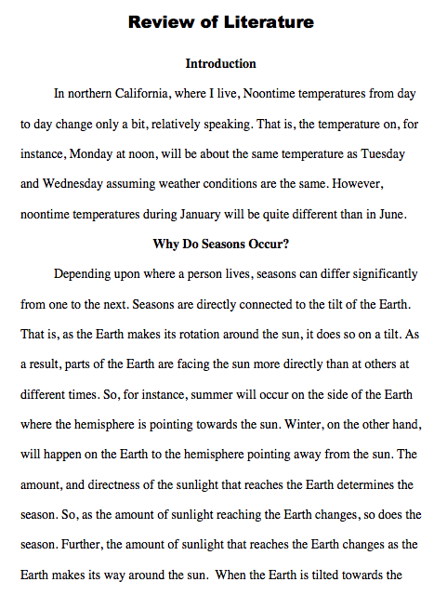

Slide 6
